Slide 1
Recruitment and Applicant Tracking Application
Team Members
K.Vishnu Sai
G.Ganesh Kumar
O.Haarisah

Slide 2
Index
Introduction
Objective
Software Required
Implementation Languages and Database Used
Results

Slide 3
Introduction
An Applicant Tracking Application is a comprehensive software solution designed to manage the end-to-end recruitment process efficiently. It automates the hiring workflow, from job posting and application receipt to candidate screening and final selection. By centralizing all recruitment-related activities and data, an ATS streamlines the recruitment process, reduces administrative overhead, and enhances both the recruiter and candidate experience. These systems are equipped with features that facilitate job distribution, resume parsing, applicant tracking, communication, collaboration, and reporting, making them indispensable tools for modern HR departments. The goal of an ATS is to ensure a seamless, efficient, and transparent hiring process, ultimately helping organizations attract, engage, and hire the best talent.

Slide 4
Objective
The main objectives of the Applicant Tracking Application project are to automate and streamline the recruitment process, enhance candidate experience through user-friendly interfaces, and centralize applicant data for efficient management and analytics. The system aims to improve efficiency by automating tasks like resume screening and interview scheduling, while ensuring compliance with data privacy regulations to protect applicant information. Additionally, it seeks to facilitate collaboration among recruiters and provide insights to optimize recruitment strategies.

Slide 5
Software Tools Required
Vs code
Xampp Sever
Local host

Slide 6
Implementation Languages
HTML
CSS
PHP
Database Used
MySQL

Slide 7
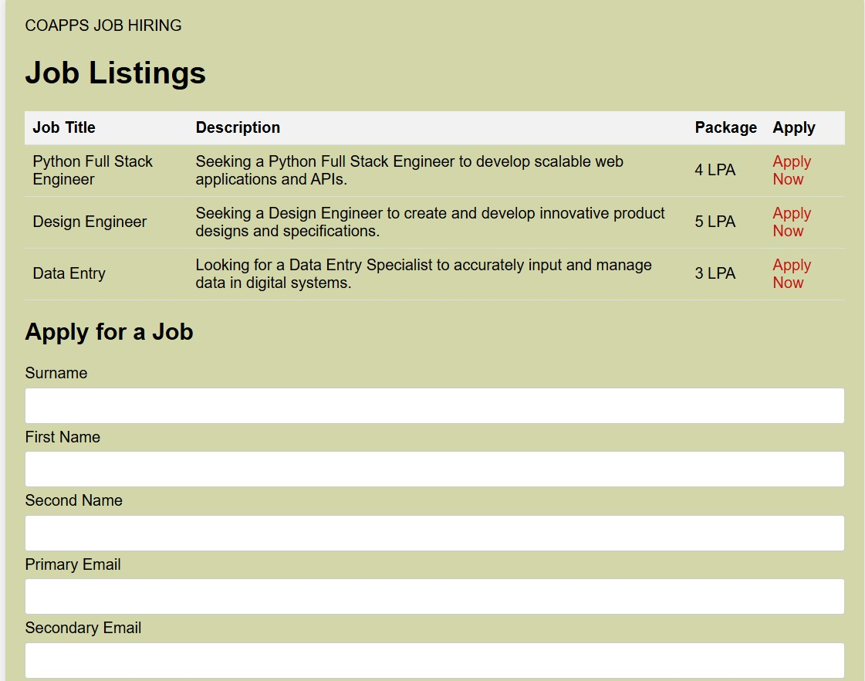
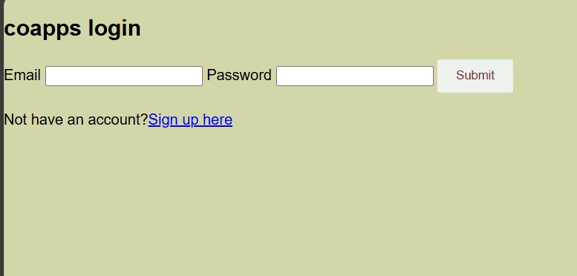
Results

Slide 8
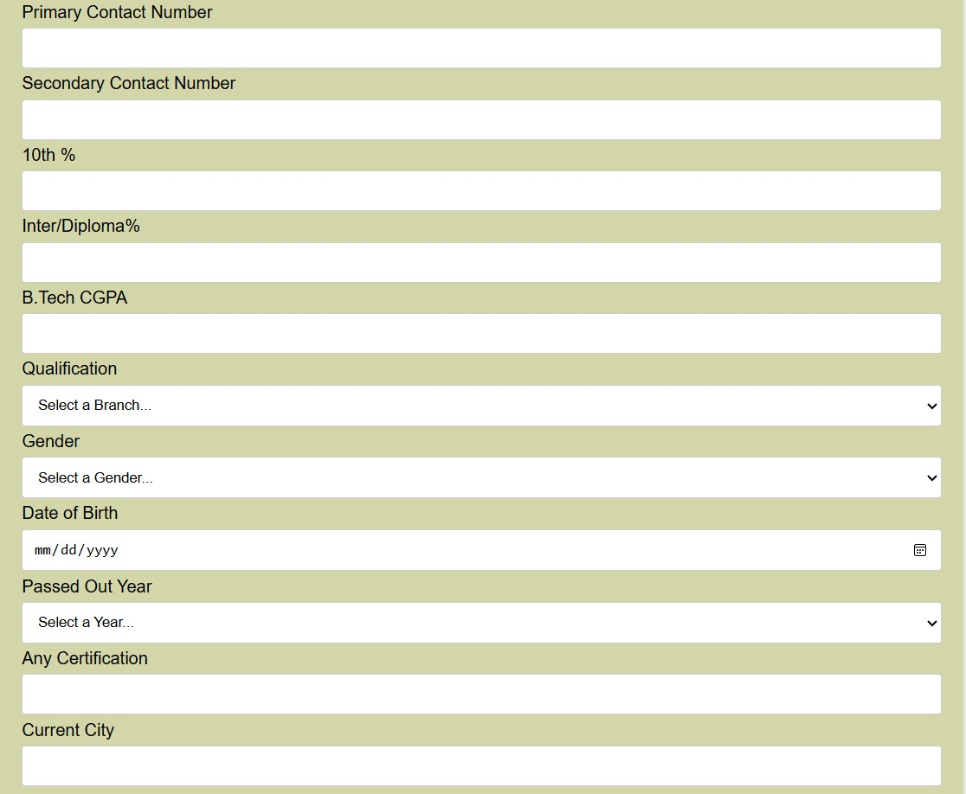
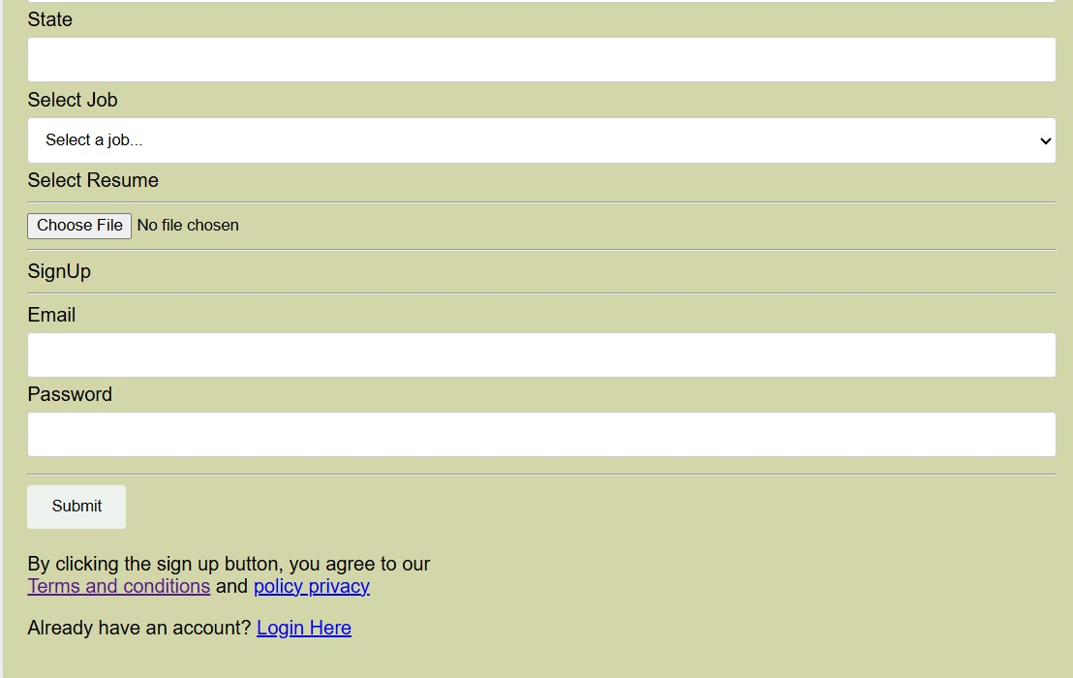

Slide 9
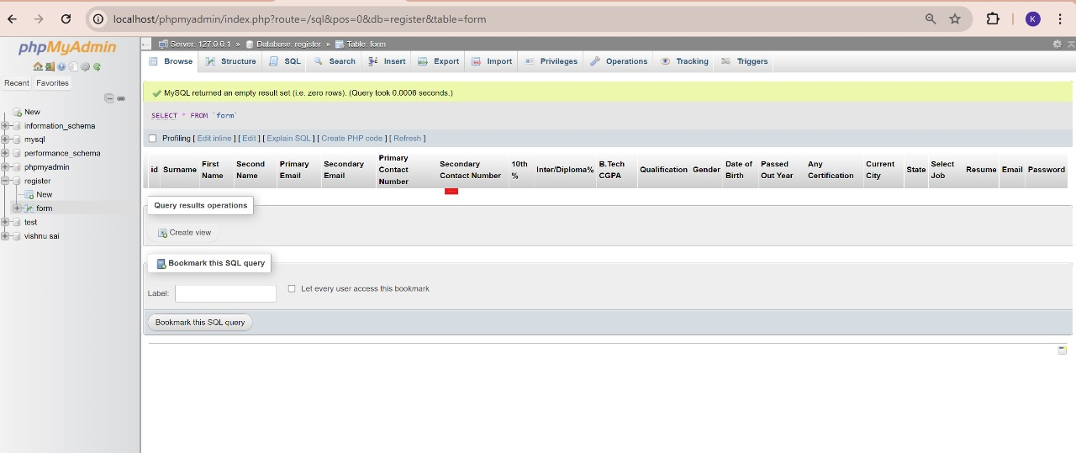

Slide 10
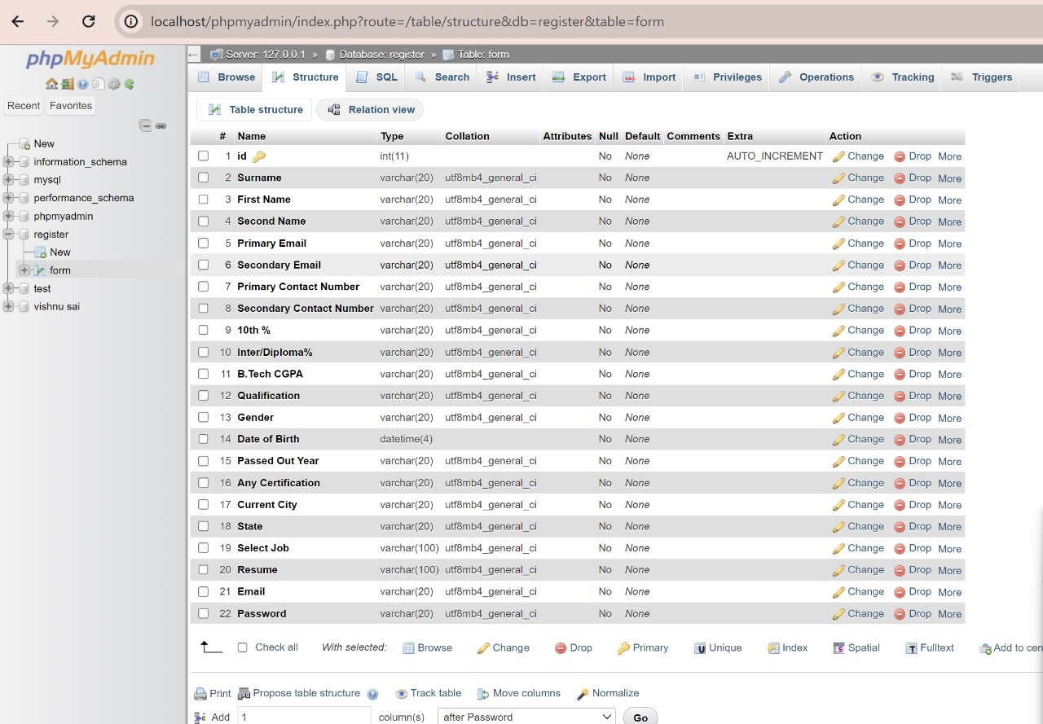

Slide 11
Conclusion
This project exemplifies how full stack development can be leveraged to create powerful and efficient web applications. By combining the front-end technologies (HTML, CSS)with back-end processing (PHP) and a relational database (MySQL), we've built a system that meets the needs of both HR professionals and job applicants. The project not only highlights the technical skills required for full stack development but also emphasizes the importance of user experience and data management in modern web applications.
By continuing to build upon this foundation, the applicant tracking system can evolve into an even more comprehensive tool that further enhances the recruitment process, making it more efficient, transparent, and effective.

